Slide 1
Global Influenza Branch (GIB) Situational and Awareness Team
National Center for Immunization & Respiratory Diseases
Data Modernization of International A Zoonoses Surveillance
Kimberly Jones, MPH

Slide 2
Background
Currently, NCIRD’s Influenza Division (ID) receives individual access individual reports of influenza A virus mainly, avian virus in animals from the World Organization for Animal Health (WOAH), World Health Information System (WAIS). ID then manually extracts animal information from the report and enters it into a virus-specific Excel spreadsheet. ID also uses complex, multi-step R-code to auto generate parts of a weekly report that are combined with some manual report building.
Subsequently, the Excel spreadsheets and R-code are used to create a weekly report containing two key artifacts:
Tables describing the weekly and all-time counts, dates of reports and animal type affected of each influenza virus pathogenicity and sub-type stratified by country.
A bullet-pointed summary describing the number of outbreaks, pathogenicity, subtype, animal type, country and assigned event_id for all outbreaks that occurred that week.
The weekly report is then shared with ID stakeholders, including leadership. Map visualizations are generated each week based on region where outbreaks occurred using the R-code.

Slide 3
Current State
Data Source | Data Description | Data Connection?
World Animal Health Influenza Reports | Reports of influenza A virus in animals submitted to the WAHIS by World Organization for Animal Health member states. | In order of preference: System connection to WAHIS Data extraction from sharepoint file Manual Entry
Notes:
Current state Christine is doing a manual pull from WOAH SharePoint site that has been deemed very time consuming and subject to human error.
We on the technical team is looking to eliminate the manual workflows.

Slide 4
Future state workflow
Workflow Description | User Group(s) | Summary of Data Sources & Integration Required | Summary of Platform Configuration Required
Data extraction from animal disease report sharepoint document | International Flu Epidemiologists | Automated extractions from excel sharepoint document | Requires development of a mechanism to extract pertinent information from large excel sharepoint (that contains all reports of all animal disease from all time).
View and Approve/Reject international animal influenza reports for inclusion into dataset of record (DoR) | International Flu Epidemiologists | International Flu Reports from sharepoint excel extraction | Workshop module showing complete line list of reports received and current status; Ability to filter line list of reports based on specified criteria; Ability update status of a report and store status of a report with the record downstream
Visualize aggregated case numbers. | International Flu Epidemiologists; International Flu Stakeholders | Approved International Flu Reports | Workshop module showing visualizations of interest, including ability to filter based on influenza virus subtype or other variables of interest
Generate summary table and updates sentences of international influenza A virus reports in animal for inclusion in a PDF and emailing to interested stakeholders | International Flu Epidemiologists | Approved International Flu Reports | Parameterized Report or Notepad
.
Notes:
Our future workflow is to have a more automated process by extracting data from excel SharePoint document.
We are asking WOAH to move their current data into NCIRD External Sharepoint (which is internal to CDC HQ) for a more automatic workflow
NCIRD technical would then have the ability to connect internally to this SharePoint site

Slide 5
Data Model
Notes:
We are asking WOAH to move their current data into NCIRD External SharePoint (which is internal to CDC HQ) for a more automatic workflow
NCIRD technical would then could connect internally to this SharePoint site using Azure Client ID/Username and Password
The data will be protected and stored behind our firewalls and into our database (DCIPHER)
The technical team will be using Python as the primary programming language to clean and analyze the data
Christine will then be able to create her data visuals for her weekly reports.

Slide 6
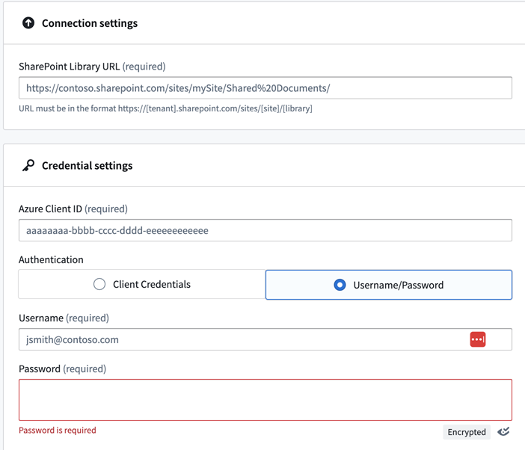
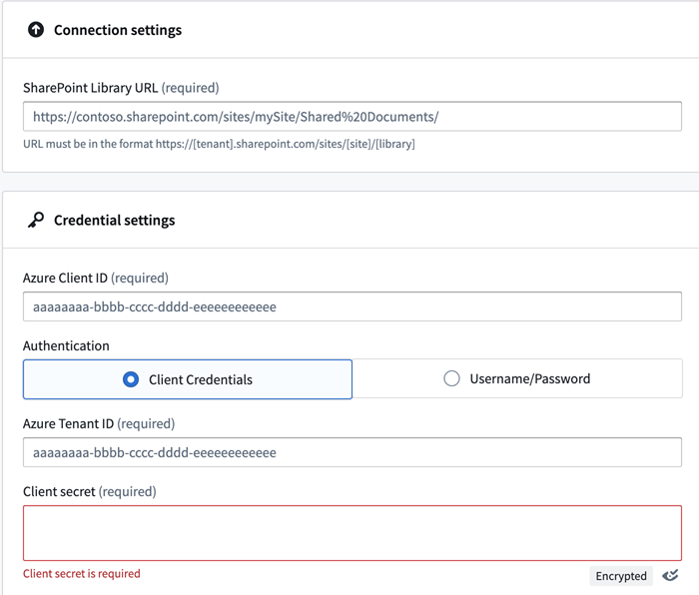
Technical Expansion
Automate data extraction by linking to WOAH Sharepoint server into DCIPHER secure on premises database
Option 1: Connect to Sharepoint Library URL by using Username & Password
Option 2: Connect to SharePoint Library URL by using Client Credentials
Notes:
The SharePoint URL specifies the library to connect to.
The Azure Client ID is the digital identity needed to process authentication to an Azure AD application.
Lastly, there are credentials in the form of Username/Password or Client Credentials.
If the Palantir DCIPHER Service Account is added to Christine’s SharePoint account, then we can use the account’s Username and Password for authentication
If we are not connecting to Christine’s Sharepoint, but to WOAH directly, we will need either a Client Credential or Username/Password here

Slide 7


